Slide 1
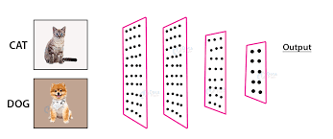
IBM – SKILLSBUILD
TNSDC-Machine Learning to Generative AI
IMAGE CLASSIFICATION
SUBMITTED BY
S.SUREKHA

Slide 2
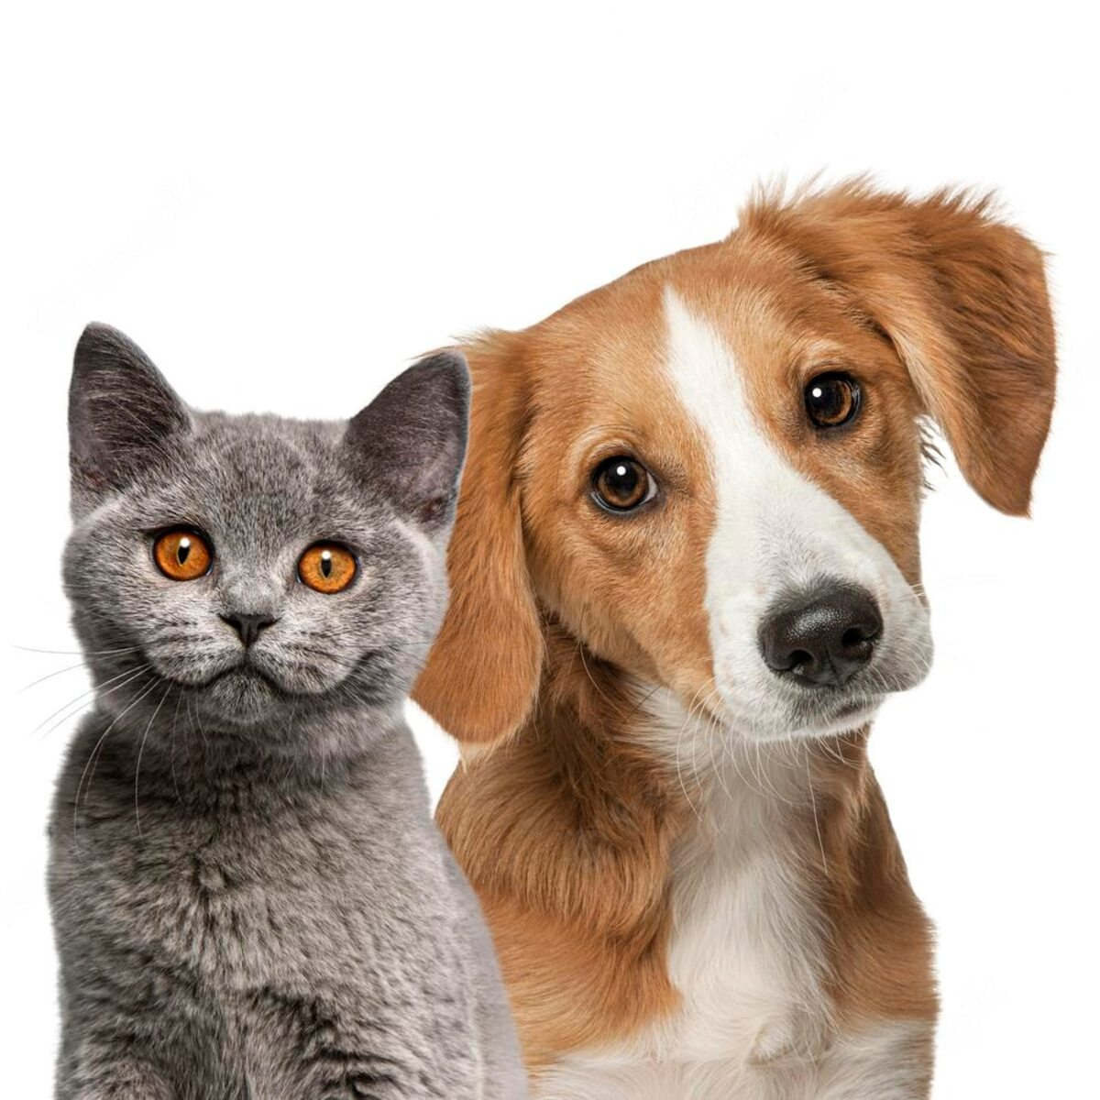
PROJECT TITLE
Image Classification using CNN

Slide 3


AGENDA
1.Problem Statement
2.Problem Overview
3.End Users
4.Solution
5.Wow Factor
6.Data Models
7. Result
3/21/2024 Annual Review

Slide 4
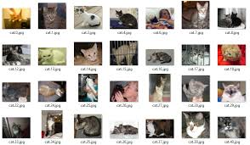

PROBLEM STATEMENT
Develop a Convolutional Neural Network (CNN) model for image classification to accurately categorize images into predefined classes or categories.

Slide 5

PROJECT OVERVIEW
1.Data Collection (kaggle.com)
2.Define the input size and number of classes
3.Data Augmentation
4.Training
5.Validation
6.Define the CNN model
7.Compile the model
8.Train and Test for single image classification

Slide 6
WHO ARE THE END USERS?
Pet Insurance Providers
2.Pet Owners and Enthusiasts
3.Animal Shelters and Rescue Organizations
4.Veterinarians and Animal Health Professionals
5.E-commerce Platforms for Pet Supplies
6.Smart Pet Devices and Applications

Slide 7

SOLUTION
Pre-Trained CNN Models: Convolutional Neural Networks (CNNs) are widely considered the state-of-the-art algorithm for image classification tasks. These models have learned rich hierarchical representations of features and can be fine-tuned on the specific cats and dogs dataset. Using pre-trained models saves time and computational resources compared to training from scratch.
VALUE PROPOSITION
Our solution leverages state-of-the-art Convolutional Neural Networks (CNNs) and advanced techniques such as transfer learning and data augmentation to achieve high accuracy in distinguishing between cats and dogs in images. With our robust algorithms and optimized models, users can trust the accuracy of the classification results.

Slide 8

THE WOW IN YOUR SOLUTION
Convolutional Neural Networks (CNNs) are considered a highly effective algorithm for image classification compared to other traditional machine learning algorithms and even other deep learning architectures.
1.Hierarchical Feature Learning
2.Translation Invariance
3.Parameter Sharing and Local Connectivity
4.Scalability and Adaptability
3/21/2024 Annual Review
8

Slide 9
MODELS
1.ImageDataGenerator: This class is used for data augmentation.
2.train_generator: It generates batches of augmented training data
3.validation_generator: Similar to train_generator, but it is used for validation data. It generates batches of validation images.
4.Sequential Model: This is the main CNN model defined using Keras. It consists of convolutional layers (Conv2D), max-pooling layers (MaxPooling2D), and fully connected layers (Dense).
9

Slide 10
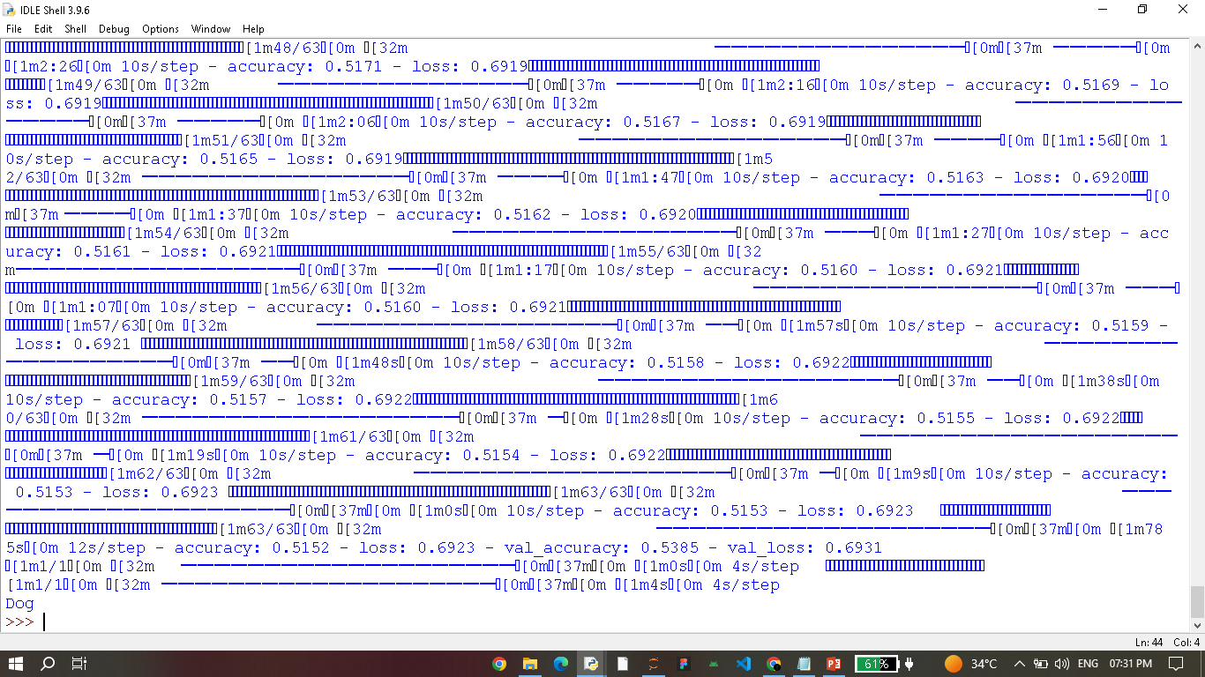
RESULT
10

